Slide 1

Complete Reporting and Documentation
CHCCCS031 - Provide individualised support (Release 1)

Slide 2
One of your responsibilities as a care worker is to document the progress of the people you support. This progress includes:
Determining the personal service requirements of the person
Coordinating care and support with the person and their support team
Identifying any situations of risk, gaps in technology or unmet needs

Slide 3

Good documentation:
Is essential when providing individualised support
Ensures continuity of quality care from all those involved in the person's individualised plan

Slide 4

4.1 Maintain Confidentiality and Privacy of the Person

Slide 5
As a care worker, one of your obligations is to maintain the confidentiality and privacy of your clients.
The Privacy Act 1988:
Details prohibitions on what information an organisation can collect
Describes how organisations handle all relevant information

Slide 6

The Australian Privacy Principles are:
Australian Privacy Principle 1— open and transparent management of personal information
Australian Privacy Principle 2— anonymity and pseudonymity

Slide 7
The Australian Privacy Principles are:
Australian Privacy Principle 3—collection of solicited personal information
Australian Privacy Principle 4—dealing with unsolicited personal information
Australian Privacy Principle 5—notification of the collection of personal information
Australian Privacy Principle 6—use or disclosure of personal information
Australian Privacy Principle 7—direct marketing
Australian Privacy Principle 8—cross‑border disclosure of personal information

Slide 8
The Australian Privacy Principles are:
Australian Privacy Principle 9—adoption, use or disclosure of government related identifiers
Australian Privacy Principle 10—quality of personal information
Australian Privacy Principle 11—security of personal information
Australian Privacy Principle 12—access to personal information
Australian Privacy Principle 13—correction of personal information

Slide 9
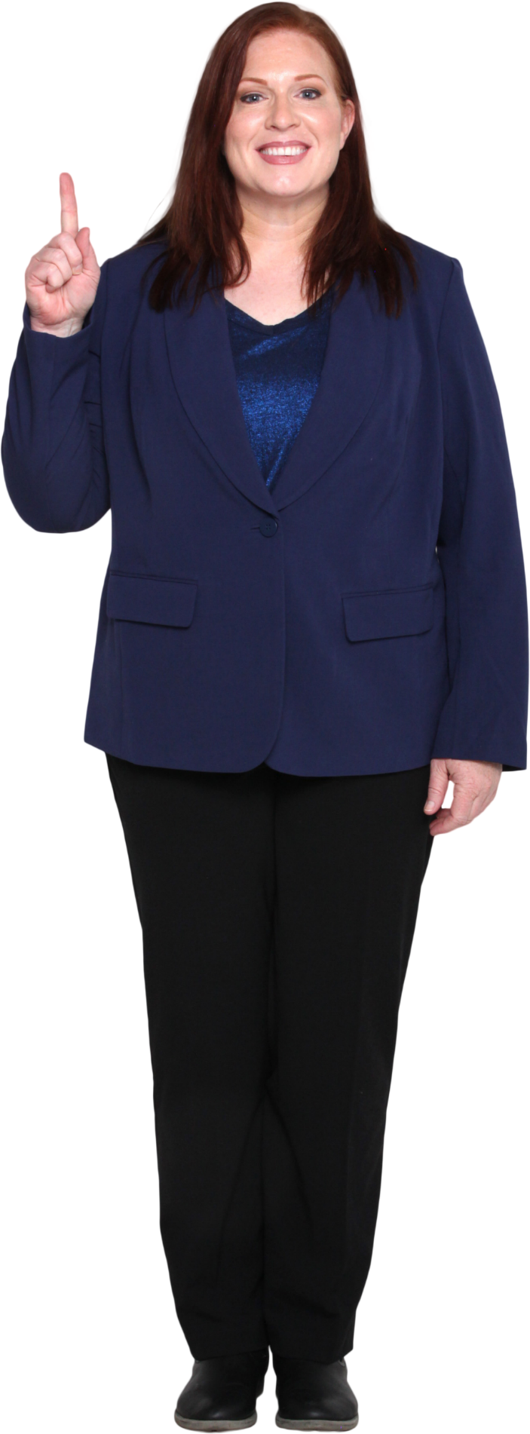
Privacy
A human right that protects a person from unwanted circumstances
Gives a person control over who can interact with them and what others can know about them
Allows a person to create boundaries and limit how others can affect their lives

Slide 10
A privacy policy:
Must be in place as you collect essential information about your clients
Is ‘a statement that explains in simple language how an organisation or agency handles your personal information’ (Office of the Australian Information Commissioner, n.d.)

Slide 11
Privacy policies must be updated to match changes to procedures on the following:
Documentation
Sharing
Storage
Use of information

Slide 12

Confidentiality
Confidentiality involves ensuring that records and documents are free of information.
This information refers to the data that can be used to identify a person or group.

Slide 13
Confidentiality of information involves identifying personal and sensitive information from relevant documents.
Once identified, they must be replaced or removed from the documents.
Personal information refers to data that can be used to identify a person.
Sensitive information relates to data on a person’s:
Background
Preferences
Lifestyle
Associations
Beliefs

Slide 14
A care worker who maintains the confidentiality of their clients must:
Assess the information in the papers to check if it identifies the client
Remove direct identifiers in documents (e.g. names and addresses)
Use aliases or placeholders to refer to the client and other relevant people

Slide 15
Use and Disclosure of Information
An entity uses personal information every time they handle your information. Using personal information includes:
Searching up a person's information
Accessing and reading their records containing your information
Making a copy of a document containing your information
Giving a copy of your information to a department within your organisation.

Slide 16
According to Australian Privacy Principle 6, an entity can use and disclose personal information only for the purpose it was collected. The exceptions to this are in the following cases where:
The individual has consented to a secondary use or disclosure
The individual would reasonably expect the APP entity to use or disclose their information for the secondary purpose
The secondary use or disclosure is required or authorised by or under an Australian law or a court/tribunal order

Slide 17
According to Australian Privacy Principle 6, an entity can use and disclose personal information only for the purpose it was collected. The exceptions to this are in the following cases where:
A permitted general situation exists in relation to the secondary use or disclosure
The APP entity is an organisation, and a permitted health situation exists in relation to the secondary use or disclosure
The APP entity reasonably believes that the secondary use or disclosure is reasonably necessary

Slide 18

According to Australian Privacy Principle 6, an entity can use and disclose personal information only for the purpose it was collected. The exceptions to this are in the following cases where:
The APP entity is an agency and discloses biometric information or biometric templates to an enforcement body.

Slide 19

4.2 Comply with Organisational Reporting Requirements

Slide 20
Reporting requirements refer to what must be communicated to the proper personnel.
These requirements can be found in your organisation’s policies and procedures for reporting, which may include the following:
Mandatory reporting
Organisational chart

Slide 21
Mandatory Reporting
Is a requirement to report any reasonable belief of abuse
Applies to any situation where you may believe that a person is at risk of the following:
Neglect
Exposure to domestic violence

Slide 22
Mandatory Reporting:
Applies to any situation where you may believe that a person is at risk of the following:
Physical, emotional or psychological harm
Sexual harm
Financial abuse
Abandonment

Slide 23
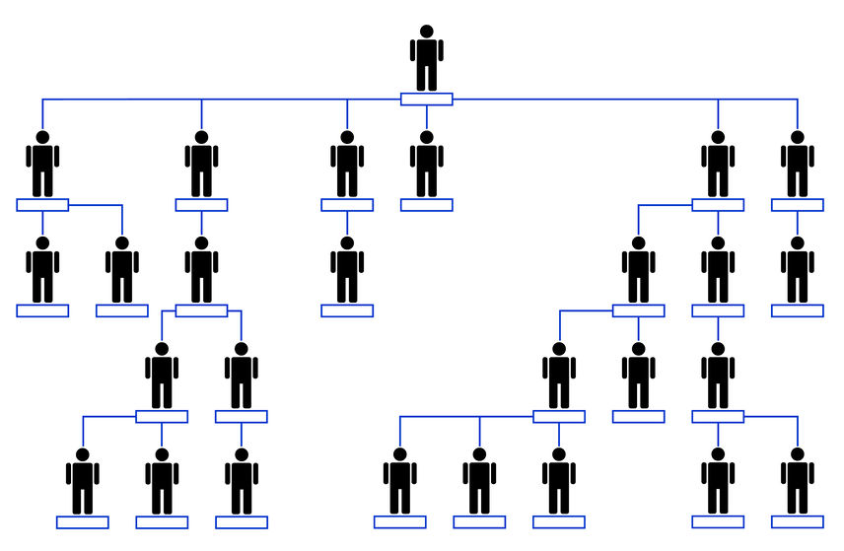
Organisational Chart
Refers to the structure of an organisation
Tells you to whom you will report within your workplace
Also helps you define your role and identify who is supposed to supervise you

Slide 24
Make sure to refer to your organisation’s policies and procedures for reporting. These usually include:
The definition of your role within the workplace
Who you should report to
The steps for reporting to your supervisors

Slide 25
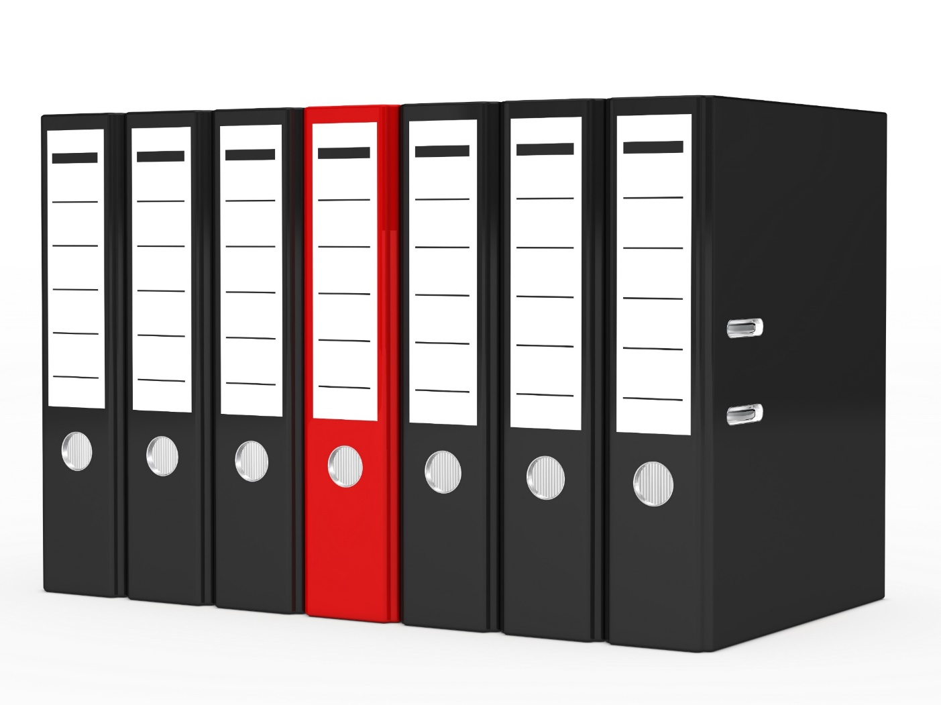
4.3 Complete, Maintain and Store Documentation and Reports

Slide 26
Your organisation’s policies and procedures may include the following requirements:
Style guide
A style guide sets the standards to follow when recording data.
Records storage
It is part of your responsibility to securely store all documents and reports within your organisation’s database.

Slide 27

Your organisation’s policies and procedures may include the following requirements:
Privacy, confidentiality and disclosure
Clients have the right to decide on what information others can know and what should be kept confidential.

Slide 28
Types of Documents and Reports
Part of your responsibilities is creating documents and reports about the people in your care. These files usually follow a format depending on your organisation which include:
One-page profiles
Learning log
Communication profile and chart
Progress notes
Workplace reports
Workplace checklists

Slide 29
One-Page Profiles
Serves as the foundation for individualised support
Contains vital information about the client on a single sheet of paper to be quickly shared with others
Profiles should contain the following elements:
Appreciation
Priorities
Support

Slide 30
Learning Log
This is used to communicate the client’s service delivery.
This tool is essential for a client who:
Does not use words to communicate
Tends to say things to please others
Has others who speak on their behalf
Means something different than what they said

Slide 31

Communication Profile and Chart
A communication profile and chart are used to understand how a client converses with others.
A communication profile is used to record how the client communicates and what communication they understand.

Slide 32
Progress Notes
Are part of the person’s record where healthcare workers and support personnel record the person’s progress and achievements and other observations
Need to be documented and reported as they serve as a communication tool for different staff supporting the person
Act as proof of service delivery and constitute a legal record.

Slide 33
Progress Notes
Progress notes should contain the following:
Baseline assessment of client before service delivery
Timeline of the client's support services and activities
Descriptions of the activities and their expected outcomes for the client

Slide 34
Progress notes should contain the following:
Summary of progress to date
Any challenges noted by personnel assisting the client per activity
Observations and assessment of the client after the activity
Plans for further development

Slide 35
Progress Notes
There are numerous formats you can use for progress notes:
Subjective, Objective, Assessment, Plan (SOAP) – SOAP has four categories:
Subjective
Objective
Assessment
Plan

Slide 36
Progress Notes
There are numerous formats you can use for progress notes:
Data, Assessment, Plan (DAP) – DAP condenses the SOAP format into three categories:
Data
Assessment
Plan

Slide 37
Progress Notes
There are numerous formats you can use for progress notes:
SOAIGP – Compared to SOAP and DAP format, the SOAIGP format provides more detail and includes the following:
Supplementary database information
Observations
Activities
Impressions
Goals
Plans

Slide 38
Workplace Reports
When completing any workplace report, make sure you include all important details such as:
Who was involved?
What happened?
Where did it happen?
When did it happen?
Why did it happen?
How did it happen?

Slide 39

Workplace Checklists
Checklists are mostly based on observations.
In a checklist, you will find conditions that must be met or tasks that must be done.

Slide 40
Workplace Checklists
When completing a checklist, you must state:
Your name
Your position
Current date
Name of the person to whom the checklist applies

Slide 41
Completing Documentation and Reports
Consider the following when completing required documentation and reports according to organisational policies and procedures:
Check if there is any missing information.
Include only the relevant information in the document or report.
Use plain and formal language.
Keep all documentation and reports objective.

Slide 42
Maintaining Documentation and Reports
Consider the following when maintaining documentation and reports according to organisational policies and procedures:
Regularly update files with new information.
Have a timeline for review.
Have a process of documentation control.

Slide 43
Storing Documentation and Reports
To safely store documentation and reports according to your organisation’s policies and procedures, you may do the following:
Store physical files where you can protect them from physical damage.
Store digital files in the correct folders based on your organisation’s system.
Make sure files are kept where they will remain confidential.

Slide 44

What have we learnt?
In this part of the session, we have covered:
Determine personal support requirements
Provide support services
Monitor support activities
Complete reporting and documentation

Slide 45
End of Chapter 4

Slide 46

Presentation Objectives
Now that you have completed this presentation, you should be able to:
Determine personal support requirements
Provide support services
Monitor support activities
Complete reporting and documentation

Slide 47
End of CHCCCS031 Presentation

Slide 48
Version Control & Document History
Date | Summary of Modifications | Version
13 January 2023 | Version 1.0 released for publishing | 1.0
14 April 2023 | Version 1.1 endorsed for use Minor revisions for improved readability | 1.1
25 May 2023 | Version 1.2 endorsed for use Added discussions on manual handling | 1.2
22 August 2023 | Version 1.3 endorsed for use Fixed wording issues | 1.3
18 October 2023 | Version 1.4 Contextualisation for IIET | 1.4

